Slide 1
CS 4530
Fundamentals of Software Engineering
Module 17A: Engineering Ethical Software
Adeel Bhutta, Mitch Wand
Khoury College of Computer Sciences
© 2025 Released under the CC BY-SA license

Slide 2
Learning Goals
By the end of this lesson, you should be able to…
Illustrate how software can cause inadvertent harm or amplify inequities
Explain the role of human values in designing software systems
Explain some techniques that software engineers can use in producing software systems that are more congruent with human values.

Slide 3
Ethically and morally implicated technology is everywhere!
Algorithms that gate access to loans, insurance, employment, government services…
Algorithms that perpetuate or exacerbate existing discrimination
Bad medical software can kill people (Therac-25)
UIs that discriminate against differently-abled people
Third-party data collection for hyper-targeted advertising
LLM's that harvest copyright or personal data
And on… and on… and on…
Notes:
<Read Slide, with ad lib details as you wish>

Slide 4
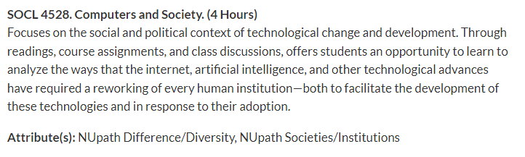
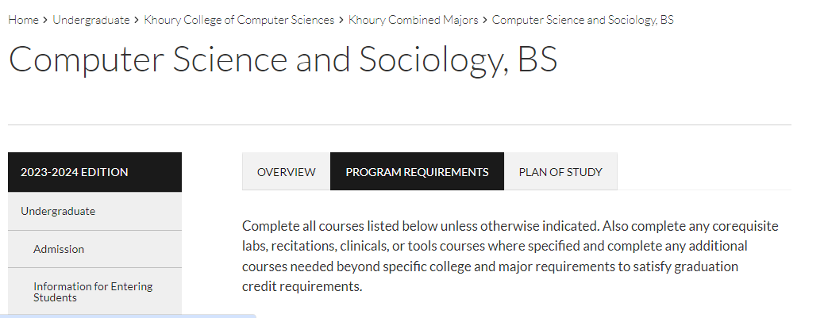
And this is only the tip of the iceberg
Other Challenges:
interfaces and systems designed to be addictive;
corporate ownership of personal data;
weak cyber security and personally identifiable information (PII) protection;
and many more …
Notes:
The more we understand the different ways in which our software affects individuals and society at large, the better we can become at avoiding or mitigating such negative effects.
Why, you could teach a whole course about it!
<click>
Or even a whole program
<click>

Slide 5
Equity and Software
As new as software engineering is, we’re newer still at understanding its impact on underrepresented people and diverse societies.
We must recognize imbalance of power between those who make development decisions that impact the world.
and those who simply must accept and live with those decisions that sometimes disadvantage already marginalized communities globally.
Quote: “Software Engineering at Google: Lessons Learned from Programming Over Time,” Wright et al, 2020 (O’Reilly)
Notes:
There is an enormous imbalance of power between those of us who make software development decisions, building software that’s used broadly, and the rest of the world that simply must accept and live with those decisions. As software engineers, you will likely wield more power than you realize.

Slide 6
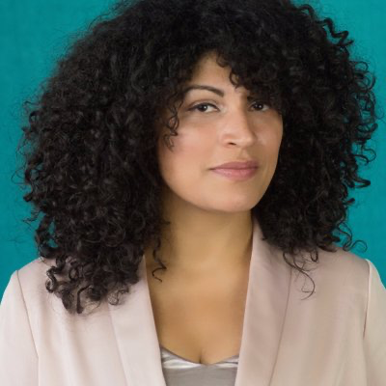
Recognize inequities in your software
One mark of an exceptional engineer is the ability to understand how products can advantage and disadvantage different groups of human beings
Engineers are expected to have technical aptitude, but they should also have the discernment to know when to build something and when not to
Demma Rodriguez Head of Equity Engineering, Google 2018-2020
Meta 2020-2022
AirBnB 2022-present
Quote: “Software Engineering at Google: Lessons Learned from Programming Over Time,” Wright et al, 2020 (O’Reilly)
Notes:
Being an exceptional engineer means not only that you know HOW to build some great features, but that you have the judgement to be able to identify and reject features or products that drive adverse outcomes.

Slide 7
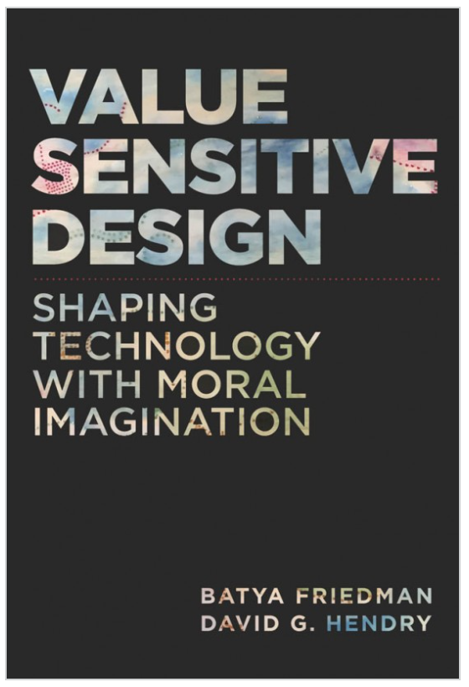
What values might our software promote or diminish?
Human rights - Inalienable, fundamental rights to which all people are entitled
Accessibility - Making all people successful users of the technology
Justice - Procedural justice (process is fair) + distributive justice (outcomes are fair)
Privacy - An individual’s agency in determining what information about them is shared
Human welfare - Physical, material and psychological well-being
Value Sensitive Design @ Khoury

Slide 8
To analyze this question, we have to understand the human and social contexts in which our software will run

Slide 9
Some categories of contexts:
Social Context
Business Context
Legal and Regulatory Context

Slide 10
What is the social context?
what categories of people will benefit from our software?
what categories of people will be harmed by the use of our software?

Slide 11
What is the business context?
Who is going to pay for this software?
users?
advertisers?
sponsors or sponsoring agencies?
What are their incentives?
how do their incentives affect (or distort) our priorities in designing or developing this software?
if our sponsors are selling advertising, then we may be pressed to prioritize "engagement"
if our sponsors want to help disadvantaged people to connect with services, we may be pressed to prioritize accessibility.

Slide 12
Who is selling what to who?
"If you're not paying for the product, then you are the product"
--
generally credited to Richard Serra and Carlota Fay Schoolman (1974, about TV advertising)

Slide 13
What is the legal and regulatory context?
Americans with Disabilities Act (ADA)
Litigation-averse sponsors may insist on elaborate Terms & Conditions
Software for use in the EU may need to comply with the GPDR.
What about financial software?
What about personal data?
What about leaving cookies, etc., on our machines?

Slide 14
Is the activity of the software transparent?
What data does it collect about the individual user?
Does it store things on our computers?
Does it touch our files?
Does it violate the "CIA" of computer security?

Slide 15
Special considerations for AI
Incentives for AI system may be particularly mysterious
What objective function is your LLM optimizing?
AI "agents" that operate in the real world present particularly complicated risks

Slide 16
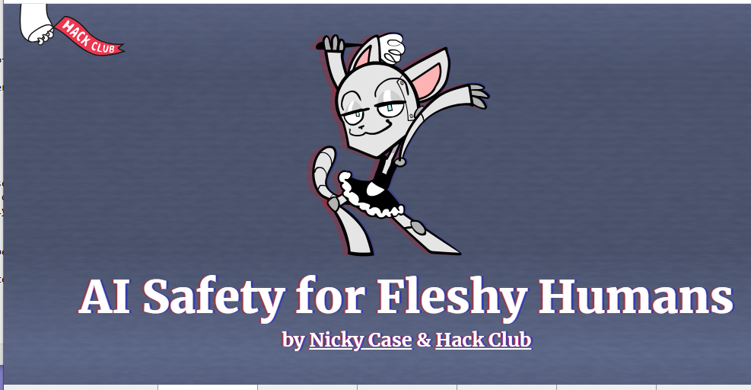
A short course in AI safety
aisafety.dance

Slide 17
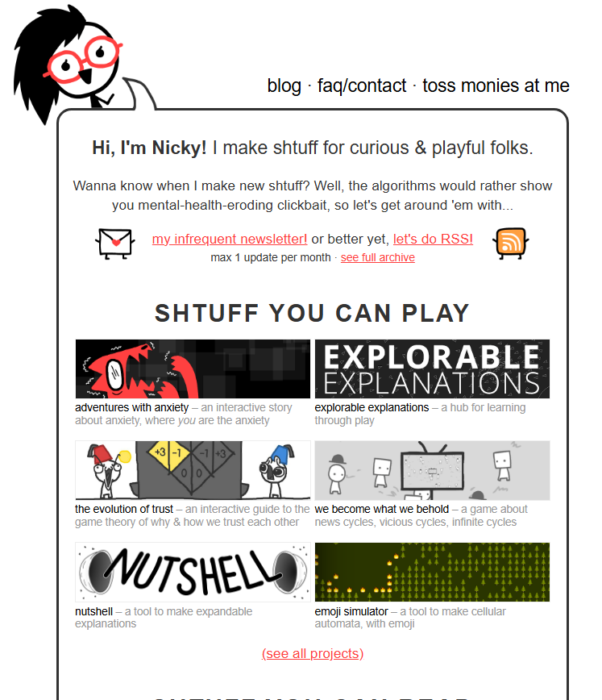
A short plug for Nicky Case
ncase.me

Slide 18
Consider human values throughout the project
Projects evolve, often in unpredictable ways
New issues may arise as the project is elaborated
Users will ALWAYS use the software in unexpected ways
Users will ALWAYS find ways to misuse the software

Slide 19
Identifying Unintended Consequences
Technology will be adopted in unanticipated ways. Being intellectually rigorous means considering and mitigating risks in designs ahead of time.
What if:
Our recommendation system promotes misinformation or hate speech?
Our database is breached and publicly released?
Our facial recognition AI is used to identify and harass peaceful protestors?
Our child safety app is used to stalk women?
Our chatbot is sexist or racist?
Notes:
Hard to not do evil when you’re building powerful tools. <read slide>

Slide 20
Example 1: Content Moderation
The issue: free expression in tension with welfare and respect
Some speech may be hurtful and/or violent
Removing this speech may be characterized as censorship
Bad take: unyielding commitment to free speech, no moderation
Trolls and extremists overrun the service, it becomes toxic, all other users leave
Violent speech actually impedes free speech in general
Bad take: strict whitelists of acceptable speech
Precludes heated debate, discussion of “sensitive topics”
Disproportionately impacts already marginalized groups
Good take: recognizing that moderation will never be perfect, there will be mistakes and grey areas
Doing nothing is not a viable option
Clear guidelines that are earnestly enforced create a culture of accountability
Update (January 2025): Or maybe the owner's politics will dictate your site's moderation policies (or lack thereof)
Notes:
<Read slide>
Note that this is not only about the design of the software. It's about how it is deployed and administered.

Slide 21
Example 2: Image Generation
AI text-to-image generators have a well-documented bias problem. AI models are trained on images from the internet, so bias in, bias out. A recent experiment from Bloomberg on the image generator Stable Diffusion found that AI portraits of architects, doctors and CEOs skewed white and male, while images of cashiers and housekeepers skewed towards women of color.
Adobe’s solution to the bias issue was to use data that estimates the skin tone distribution of a Firefly user’s country, and apply it randomly to any human Firefly creates. In other words, if someone in the U.S. used Firefly to make an image of a doctor or a gardener, the chances that person would be a woman or have non-white skin would be roughly proportional to the percentage of women and people of color in the U.S.
In Firefly world, about 14% of doctors should be Black — the same percentage as the Black population in the U.S. But in the messy, unequal real world, only 6% of doctors are Black.
So, should AI images depict the world as it is? Or as it should be?
“That becomes almost like a philosophical question,” said Rumman Chowdhury, a Responsible AI Fellow at Harvard’s Berkman Klein Center for Internet and Society.
https://www.marketplace.org/2023/10/10/solutions-to-ai-image-bias-raise-their-own-ethical-questions/

Slide 22
There are SE-level mitigations for some of these risks
Form a diverse team
People from diverse backgrounds bring different experiences and different perspectives
Consider human values throughout the project
Rely on standards when possible
ADA
ARIA
etc.
Monitor actual usage & misusage, user feedback
who? what? when? how?

Slide 23
Systemic mitigations
Work for systemic change?
political, social, etc.
Work to convince developers to consider human values?

Slide 24
What affects developer behavior?
Standards?
Codes of ethics?
Hippocratic oath?

Slide 25

Standards can give guidance.
International bodies define standard processes that are designed to protect the public
By (correctly) following such a standard, you can reduce the chance of harm to users, as well as your ethical (and legal) liability
You can work to update/expand existing and new standards
Notes:
Areas where there are well-defined standards give the engineer more concrete guidance. For example, companies constructing medical device software must now comply with well-defined standard processes for developing that software in a way that will assure safety. Simply following the standard doesn’t guarantee safety, but doing so can help to ensure that it does, while also reducing our legal and moral liabilities.

Slide 26
ACM Software Engineering Code of Ethics
https://ethics.acm.org/code-of-ethics/software-engineering-code/
. PUBLIC – Software engineers shall act consistently with the public interest.
2. CLIENT AND EMPLOYER – Software engineers shall act in a manner that is in the best interests of their client and employer consistent with the public interest.
3. PRODUCT – Software engineers shall ensure that their products and related modifications meet the highest professional standards possible.
4. JUDGMENT – Software engineers shall maintain integrity and independence in their professional judgment.
5. MANAGEMENT – Software engineering managers and leaders shall subscribe to and promote an ethical approach to the management of software development and maintenance.
6. PROFESSION – Software engineers shall advance the integrity and reputation of the profession consistent with the public interest.
7. COLLEAGUES – Software engineers shall be fair to and supportive of their colleagues.
8. SELF – Software engineers shall participate in lifelong learning regarding the practice of their profession and shall promote an ethical approach to the practice of the profession.

Slide 27
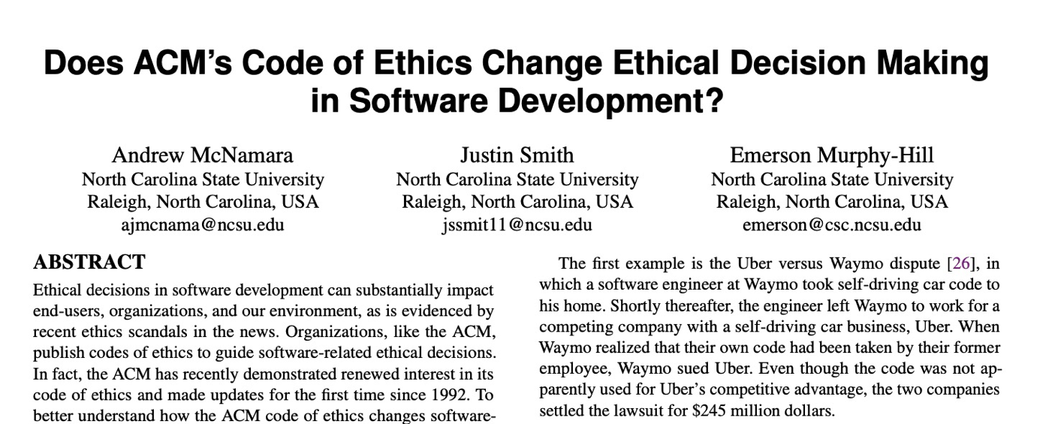
Does this code change developer behavior?
TLDR: No
Notes:
Studies have investigated whether simply exposing engineers to this code of ethics improves ethical decision making in software development
(Click)
(click),
concluding that this code alone does not improve ethical decision making.
Ethical decisions often involve weighing multiple trade-offs: in the case of the Citigroup tower, the engineering firm (and their client, and their insurer) had to make a difficult ethical choice: should they immediately publicly disclose the fact that a strong wind could topple the tower - clearly a concern in the public interest, or should they instead prepare with officials to perform an emergency evacuation and monitor the weather closely without informing the public about the potential hazard (which could provoke unnecessary panic)? A code of ethics alone does not give sufficient guidance.

Slide 28
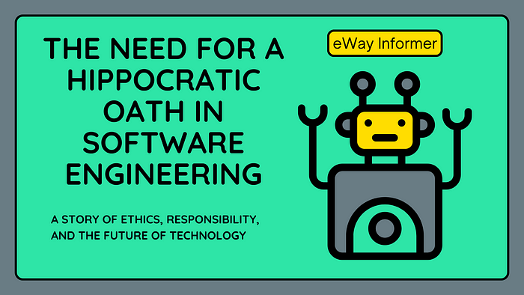
What about a Hippocratic Oath for Software Developers?
Would be formulated collectively by practitioners, not by a professional body
Reinforced by social incentives
Might this work? Who knows?
Software Engineering Needs A Hippocratic Oath

Slide 29
Where does this leave us?
So that we can sleep at night
Consider the different ways that our software may impact others
Consider the ways in which our software interacts with the political, social, and economic systems in which we and our users live
Follow best practices, and actively push to improve them
Encourage diversity in our development teams
Engage in honest conversations with our co-workers and supervisors to explore possible ethical issues and their implications.
Notes:
There’s no silver bullet for ethical software development. However, hopefully now you understand better the different ways that our software can have impacts on others, and how we can reason about those implications. We have talked about understanding users’ needs better which can be helpful in making better decisions

